Slide 1
How to Integrate Shopify?
Client Integration

Slide 2
Congratulations on the decision to integrate your Shopify webshop with cargo-partner.
Your benefits:
Global network and proven expertise
Competent advice from logistics/last-mile experts
Transport solutions by AIR, SEA, RAIL, ROAD
Dedicated customs department
Experience in cross-border e-commerce

Slide 3
Please follow the following three simple steps to integrate your Shopify webshop with cargo-partner.
This tutorial covers:
How to synchronize your Shopify Products with cargo-partner’s system?
How to synchronize your eFulfillment’s warehouse stock to your Shopify store?
How to forward your Shopify Orders to cargo-partner?
How to receive a dispatch confirmation with tracking ID in Shopify when your customer’s order leaves the warehouse?

Slide 4
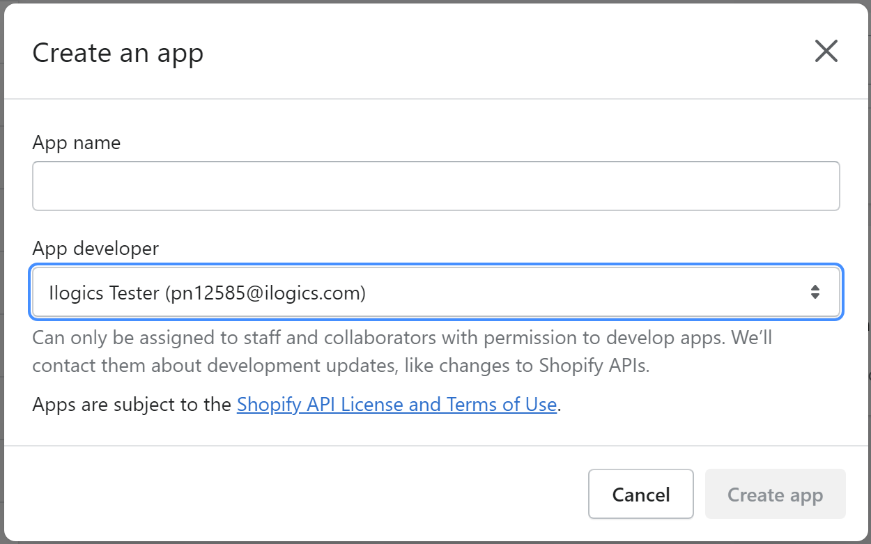
To synchronize data with cargo-partner, you have to create a Shopify App. Here's how you can set it up.
Step 1: Create your own Shopify App
Click on “Develop apps for your store”.
Log-in to your Shopify store
Click on “Apps and sales channels” within the settings.
Click on “Create an app”.
💡 Tipp
You can also visit Shopify’s official tutorial: https://shopify.dev/apps/auth/basic-http
Congrats you created your own Shopify App.

Slide 5
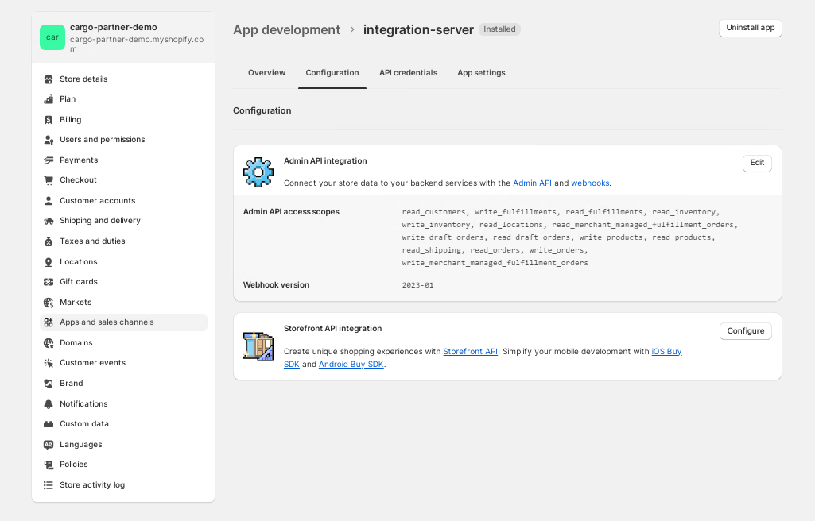
To enable all data transfer necessary for the integration configure the created app. Follow the steps below.
Step 2: Approve synchronization of data.
Setup following access scope in order to benefit from CP shopify integration
Now all data necessary will be synchronized with CP WMS.

Slide 6
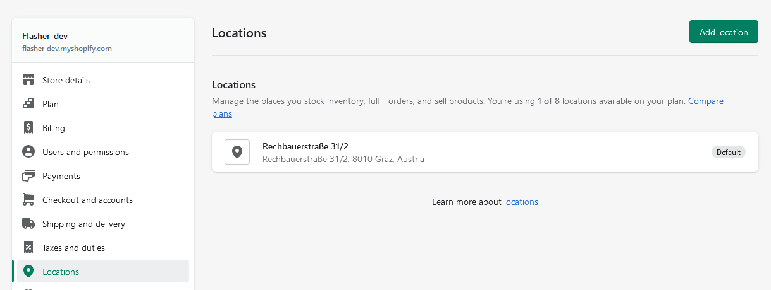
To sync inventory, you need to allow this in your Shopify app. Follow the steps below.
Step 3: Configure location.
setup a location. It can be setup in Settings > Locations. If there are more locations per shop pls inform us.

Slide 7
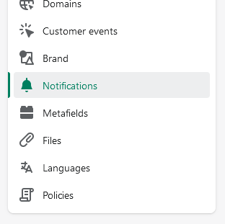
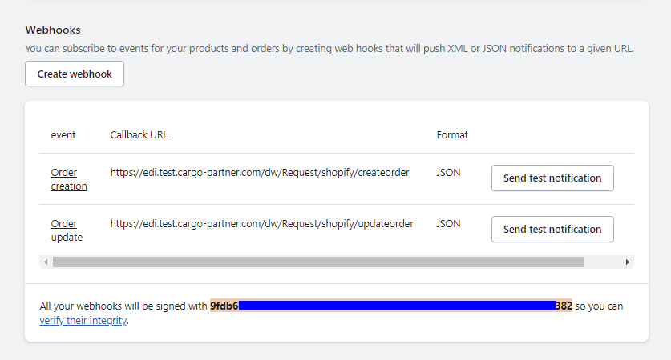
In order to push orders to CP WMS you need to set up a webhook in shopify.
Step 4: Configure webhook.
Go to Settings/Notification and click on create webhook. CP integration manager will provide you with the callback URLs.
💡 Order payment webhook will send order to CP once marked as paid in shopify
Send the webhook secret to CP securely.

Slide 8
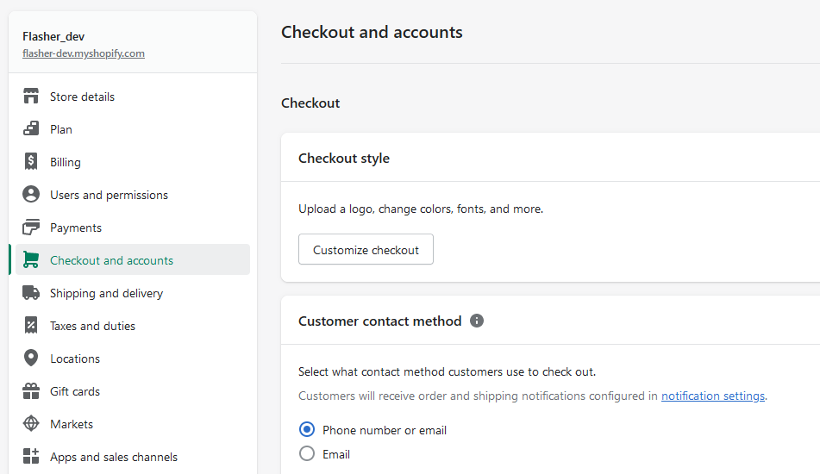
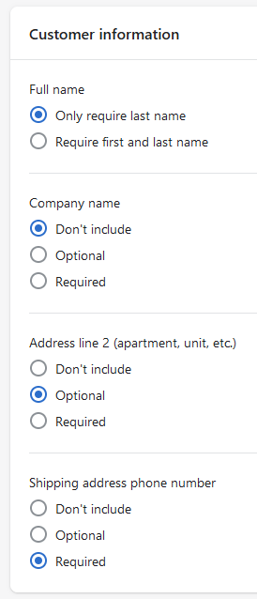
In order to process parcel orders, setup phone number. Here is how.
Step 5: Setup customer contact method.
In the same menu Checkout and accounts scroll down>
Check Required
Go to Settings/Checkout and accounts and set customer contact method to phone number or e-mail
The shipping address phone number is necessary for parcel shipments.

Slide 9
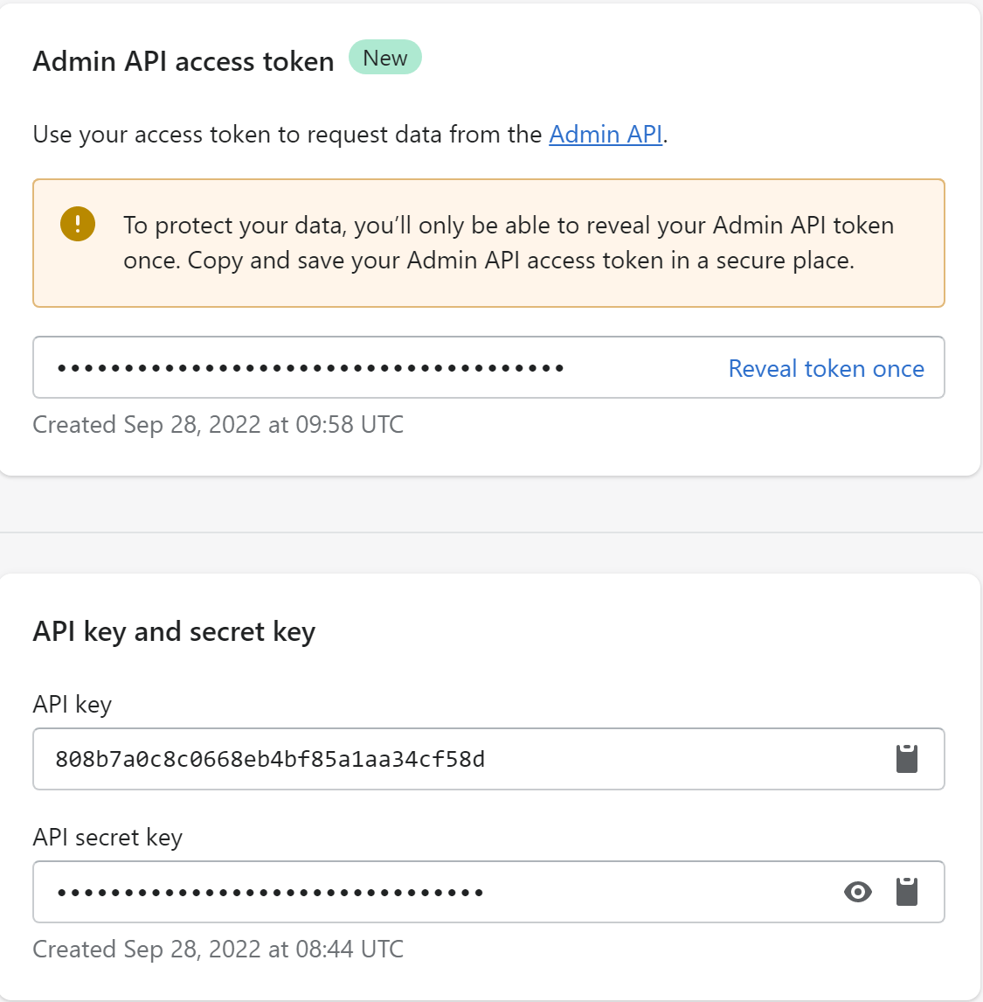
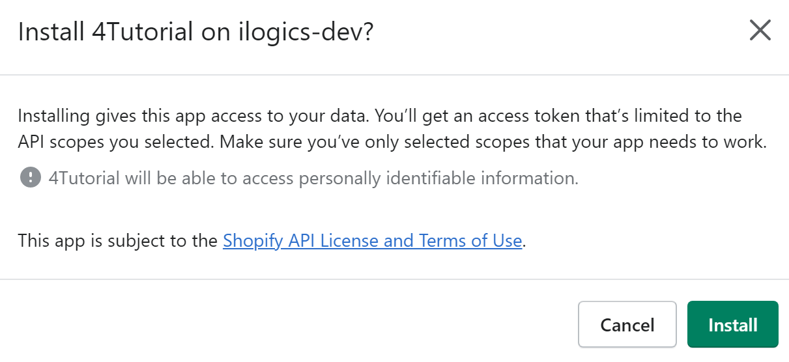
Last but not least, we need your credentials to connect us to your store. Send them to us securely.
Step 6: Share your API Access tokens
Go to “API credentials” and click on “Install app” and then “Install”
Share the following information with us:
Admin API access token
API key
API secret key
+
Webshop URL
using your preferred encryption tool (e.g., https://onetimesecret.com/).
You will find our contact details on the next slide.
You are ready. We will now integrate your shop.

Slide 10
In case of any questions, please contact:
Thomas Wehling
Solution Sales Client Integration
T +43 (59) 88811195
M +43 (664) 88342204
E thomas.wehling@cargo-partner.com
cargo-partner Ges.m.b.H
www.cargo-partner.com

